Slide 1
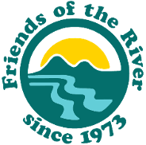


The Voluntary Agreements Are A Badly Designed Experiment That Ignores the Scientific Record
Devon Pearse, Ph.D.
Lead Scientist
Friends of the River
January 2026 Joint Presentation of
San Francisco Baykeeper and
Friends of the River
on December 2025
Revised Draft
Bay-Delta Plan Update

Slide 2
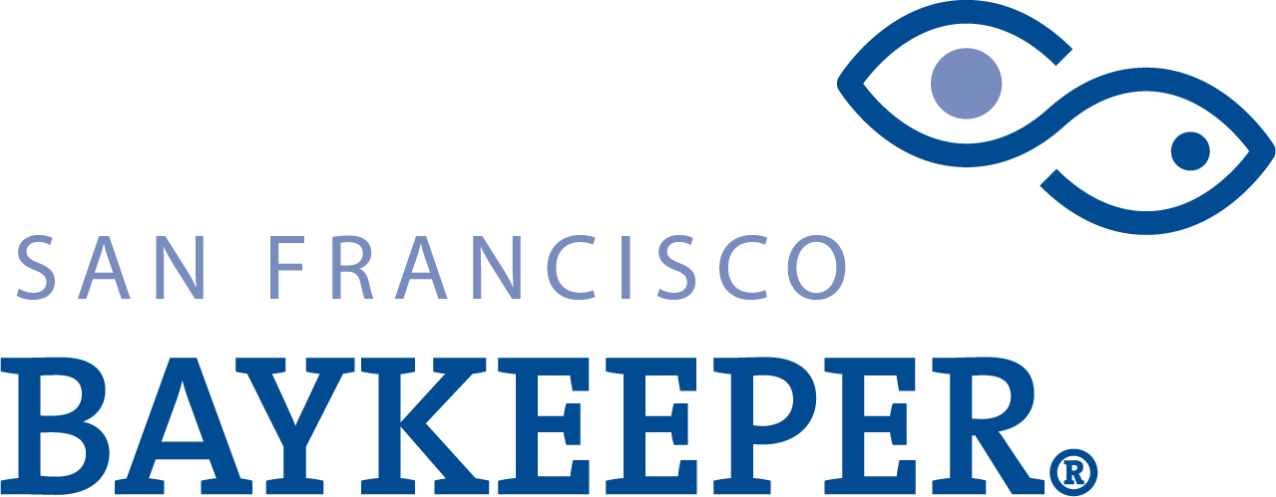
The VAs ignore the best available science showing that
Flow is the master variable
The VAs offers very limited flows at best, similar to existing conditions driving ecosystem collapse.
“Ecologically Functional Flows” would require significantly more water than offered by the VAs (Willis et al. 2022)
Flow cannot be replaced by non-flow habitat modifications.

Slide 3
Large-scale flow alteration creates a permanent drought
for the Bay-Delta estuary ecosystem

Slide 4
The VAs barely move the flow needle (if at all)
in addressing the permanent drought
VAs provide 0.8% increase Total Delta Outflows over current baseline.
(Table 13.4-91)
>Required January-June Delta Outflow as % Unimpaired Flow, 1995-2021
 | Baseline | VA | WSA | 55%UIF
Min Yr. | 8% | 8% | 36% | 47%
Median Yr. | 21% | 20% | 46% | 58%

Slide 5
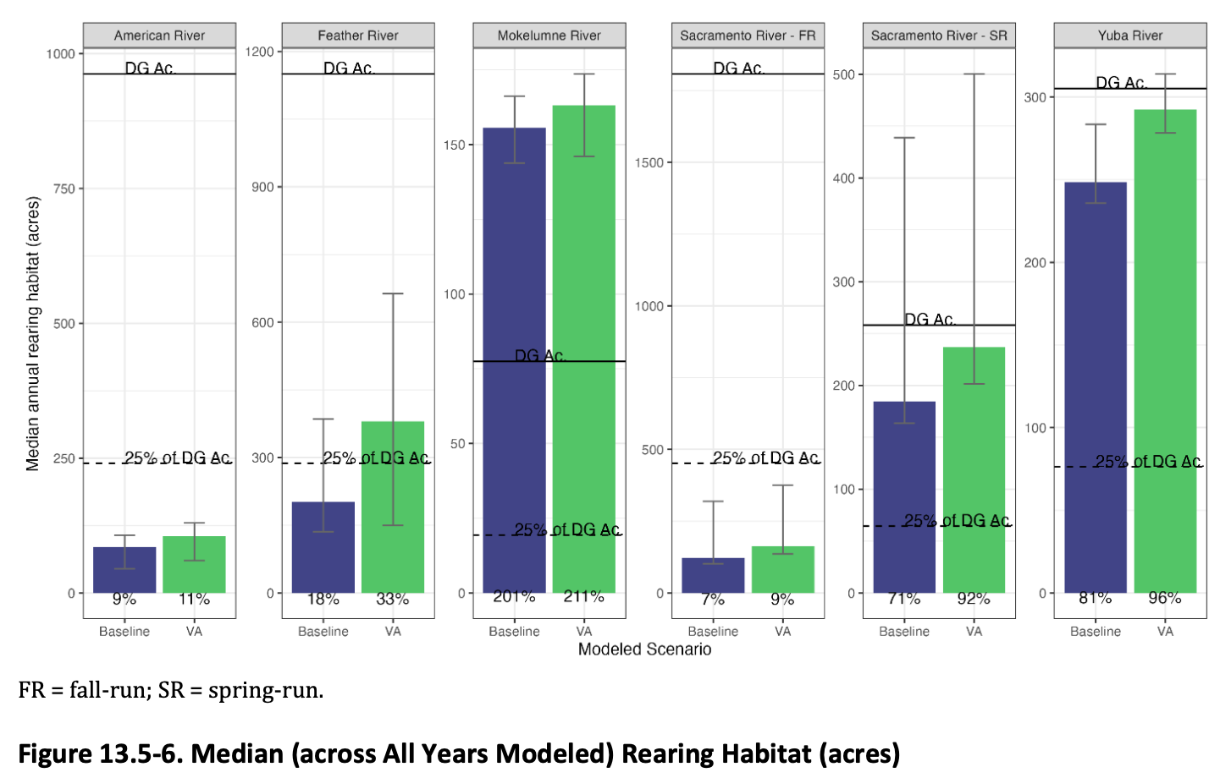
Many non-flow VA “assets” have little scientific support
Lack intentional planning.
Spawning and rearing habitat modifications that do not address the limiting factor will not help achieve the salmon doubling goal. We would expect no population response to increasing the habitat area when the population is not at carrying capacity for other reasons.
25% of doubling is not doubling.
(Tables 13.5-6 and 13.5-7)

Slide 6
Many non-flow actions have little scientific support:
“Meaningful Floodplain Event”: Meaningless without enough water or long enough duration to realize the proposed rearing benefits.
The flow conditions proposed in the VAs will lead to worse overall water temperatures for salmonids than existing conditions, and sometime much worse.
“There is a general lack of evidence in the scientific literature” that predator removals are useful tools for recovery of populations (TVA draft scientific basis report)

Slide 7
The Voluntary Agreements are a badly designed experiment
Assets were developed haphazardly, without a coherent plan.
Many details about the development of the VA assets to be determined AFTER approval.
Poor ability to evaluate scientific outcomes
Scientific evaluation of the biological response to HRL program actions is limited by insufficient replication, the 8-year time frame, low signal to noise ratio, and other factors
(Independent Peer Review-Josh Korman, 2025 Pgs. 12 to 15)
The ability to connect specific VA actions to “ecological outcomes”, i.e. responses by the ecosystem and individual fish species, will be tenuous at best
(Bay Delta Plan 4.4.9.8, pg. 91)
The science is clear
The extensive scientific record supports significant flow increases to protect fish and wildlife and other beneficial uses. The VAs ignore that record.

