Slide 1



Adopting the Draft Revised Bay-Delta Plan
Would Be a Tragic Mistake
and a Lost Opportunity (Maybe the Last One)
Gary Bobker
Program Director
Friends of the River
January 2026 Joint Presentation of
San Francisco Baykeeper and
Friends of the River
on December 2025
Revised Draft
Bay-Delta Plan Update

Slide 2
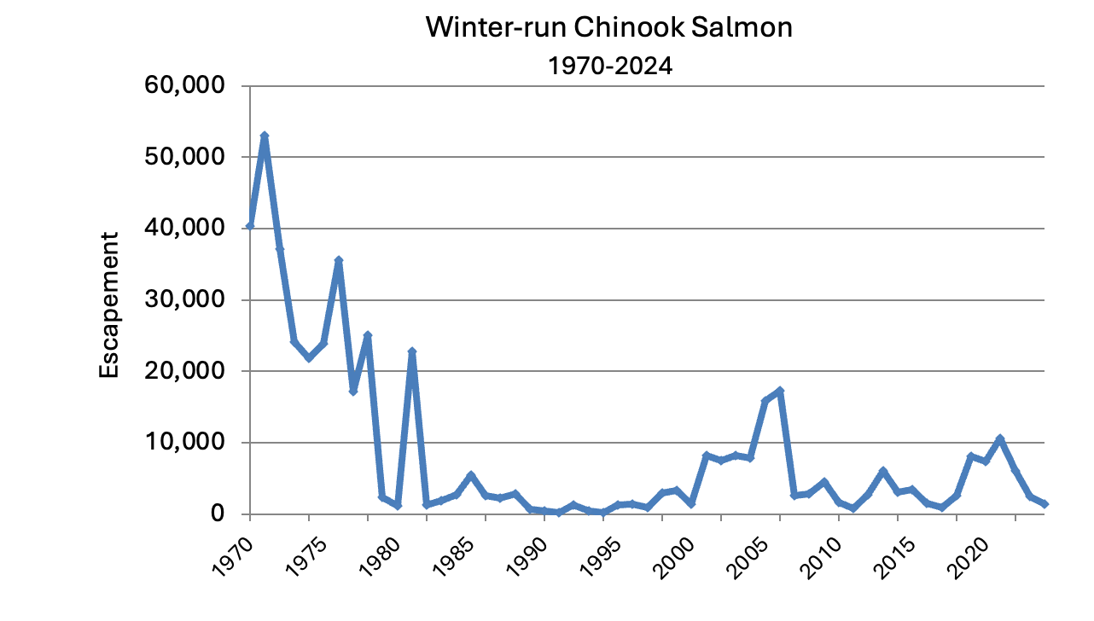
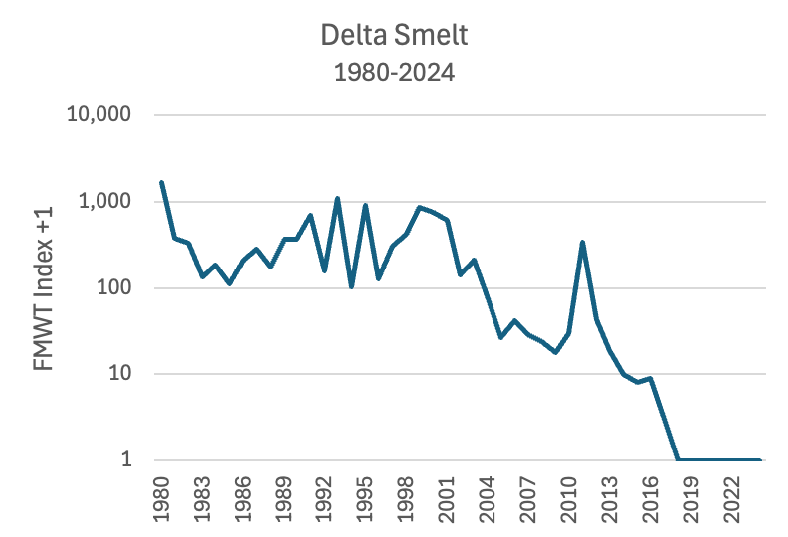
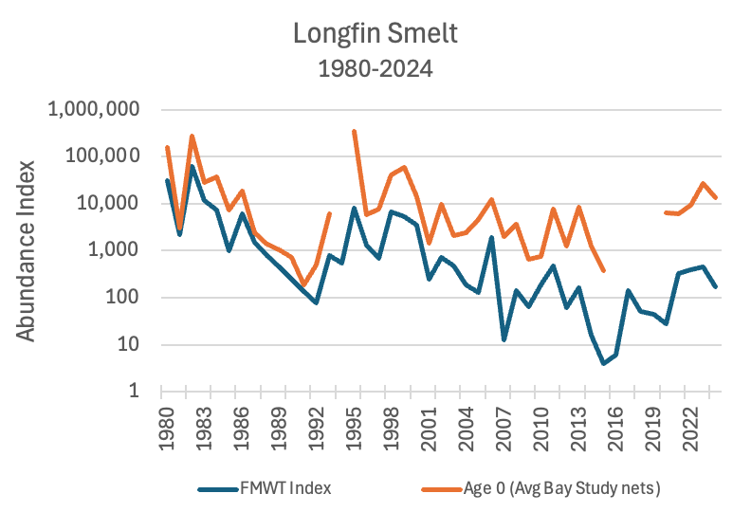
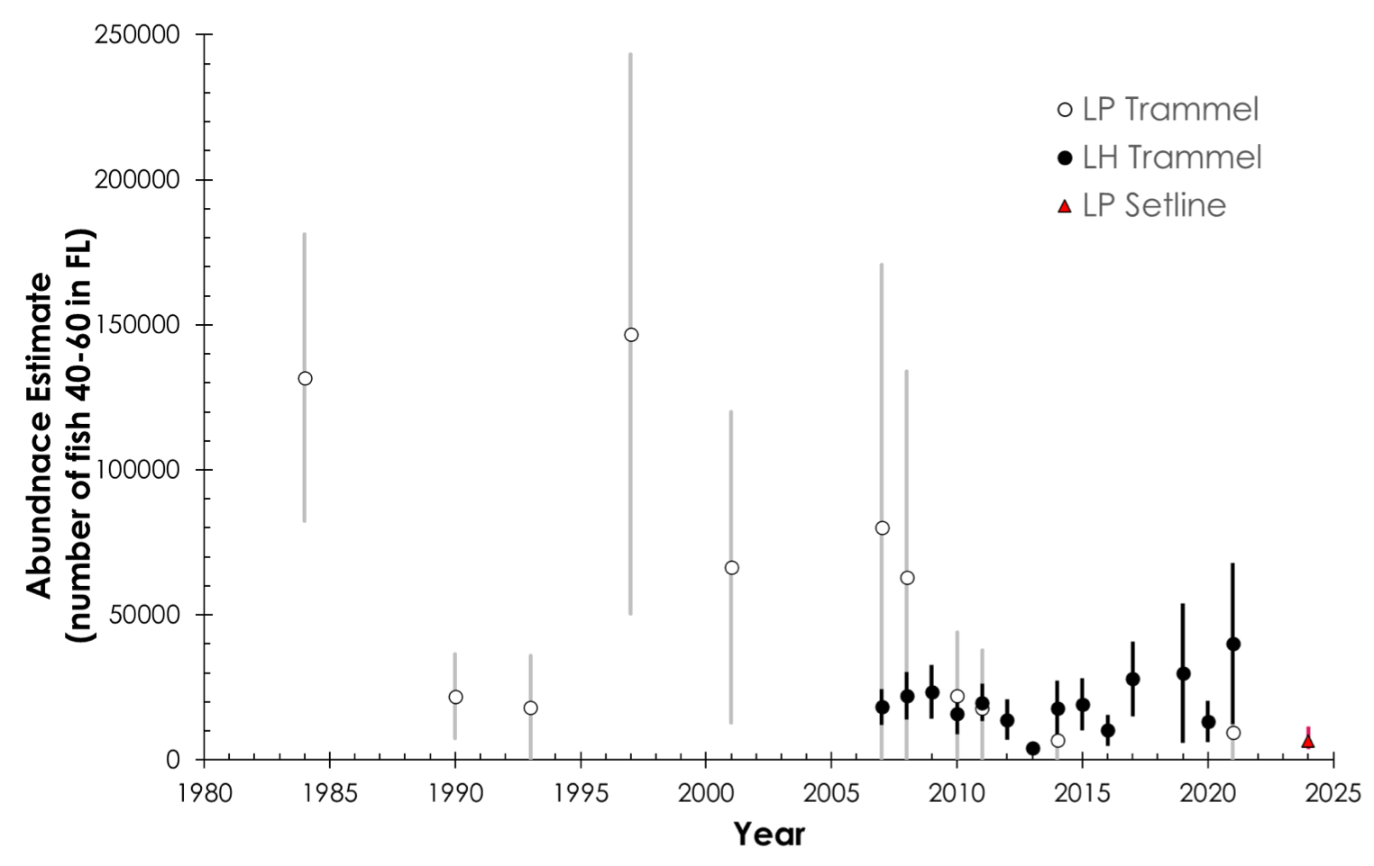
Snap Quiz: which beneficial uses are doing better?
Populations of many native aquatic organisms at or near record low levels – a systemic collapse.
Commercial salmon fishery closed for three years.
Increasing frequency of toxic algal blooms.
Extinction of biological resources and permanent loss of fish and wildlife beneficial uses increasingly likely
White Sturgeon
1980-2025

Slide 3
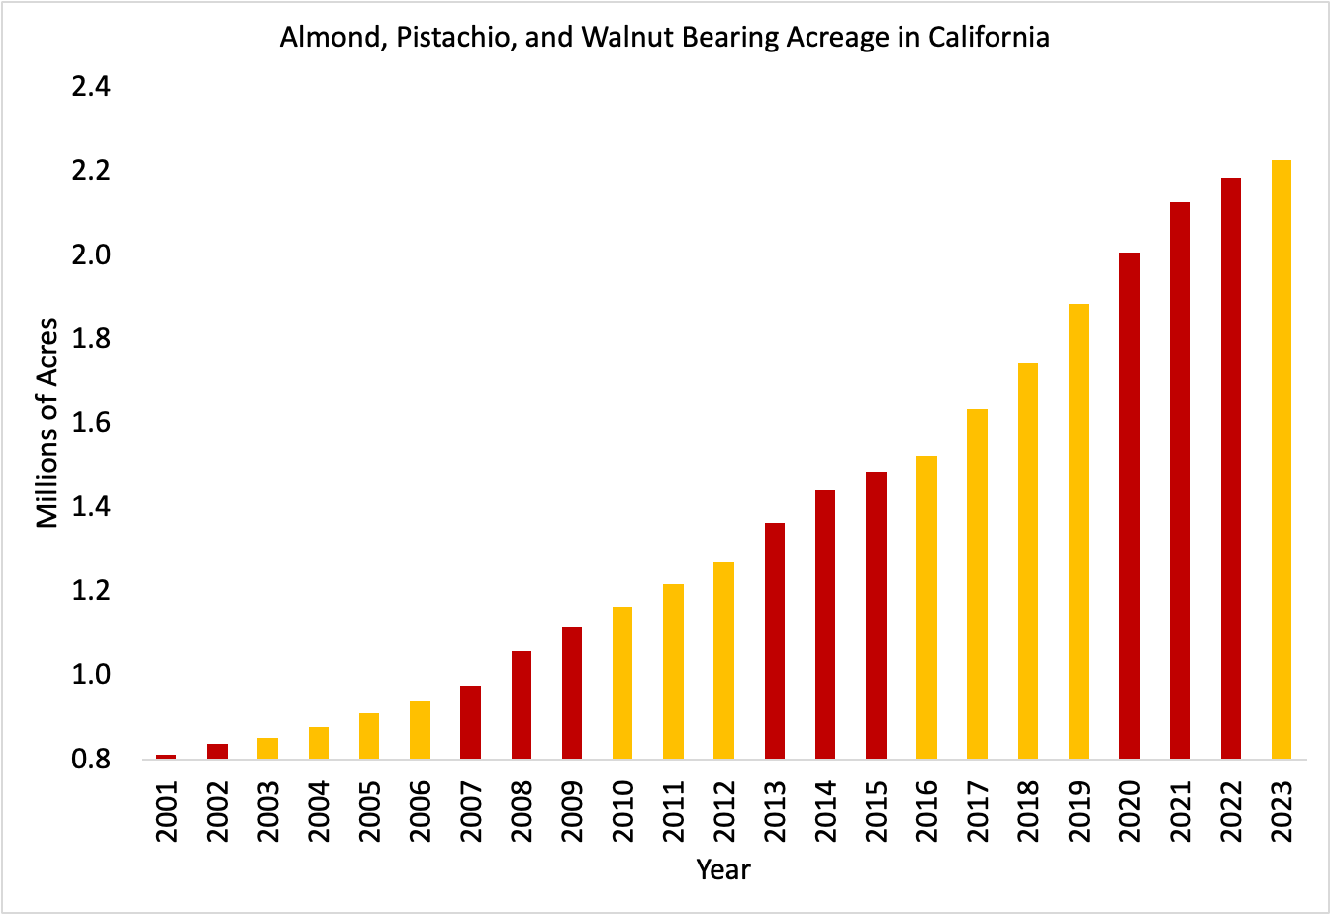
Snap Quiz: which beneficial uses are doing better?
Tree crop acreage nearly doubled over the past decade
Agricultural revenues steadily increased over the same period
Largest developed water use very resilient to changing conditions
Source: FOR, from CDFA, USDA and other sources
Source: D.A. Sumner. 2025. UC Davis

Slide 4
“We can endure neither our vices nor their cure.” (Livy, History of Rome)
The Board has known for over twenty years that native fish populations were collapsing and fish and wildlife and other beneficial uses at great risk.
Starting in 2010 the Board has compiled a comprehensive and compelling body of scientific evidence that flows are the driver of ecological condition in the estuary, and that large-scale improvements are required to protect the estuarine ecosystem, sustainable fisheries, and water quality.
During the same period, the Board has compiled a similar body of evidence that the nominal flows and proposed habitat actions of the Voluntary Agreements will not come near to supporting these uses.
The Board could have acted on this extensive record, but it delayed the update of the Sacramento-Delta portions of the Plan and the implementation of the San Joaquin update to accommodate the VAs (which will not work, and are not supported at all by conservation, tribal, or Bay-Delta regional interests).
Outlier effects of protective flow standards can be addressed using a more sophisticated and watershed-specific approach, rather than the one-size-fits-all Water Supply Adjustments that would dramatically weaken the regulatory framework.

Slide 5
This is not a drill. Is failure really an option that this Board is willing to choose?
There is a rapidly increasing likelihood that species will go extinct and ecosystem functions will be permanently impaired if the Board delays putting in place evidence-based standards and instead opts for a VA approach that preserves the status quo and a gutted regulatory backstop of WSAs.
Why expect a future Board to do in eight, twelve or twenty years what this Board is not willing to do now? Why even assume that a future Board’s actions will even be timely or relevant to saving beneficial uses at risk?
Staying on the current course represents a total failure of the Board to fulfill its charge. Please - don’t let that be your legacy.

