Slide 1

Big Storage
Can we dam our way to Paradise anymore?
Some Supply-Side Meditations
Valley Water Consortium
H20 III, Distilling Sustainable Solutions
March 10, Fresno City College, Social Science Building
Presented by Ron Stork, Friends of the River

Slide 2
Some Basics
Statewide water use:
40/42 million acre-feet per year
Demand profile:
80% agricultural, 20% urban
Source:
Roughly 50% groundwater, 50% surface water
swinging with surface water availability

Slide 3
More Basics
Central Valley Project (CVP):
7 million acre-feet per year deliveries
9 million acre-feet per year control
Unpaid CVP reimbursable costs approximately $1.3 billion
State Water Project (SWP):
Average deliveries more than 2 million acre-feet/year
Average Groundwater Overdraft
2 million acre-feet per year
(mostly San Joaquin Valley)

Slide 4
Statewide Storage Factlets
Statewide Surface Storage
42 million acre-feet
Central Valley Groundwater
683 million acre-feet (1975 California Water Atlas)
Urban Southern California (San Gabriel, San Fernando, Santa Anna, San Jacinto river and mountain watersheds) 109 million acre-feet
(1975 California Water Atlas)

Slide 5
Cal Fed Investigation Dams
California Water Storage Projects developed since 1990 (September, 2016)
Project | Size (acre-feet) | Description
Kern | 2,500,000 | Groundwater aquifer developed jointly by Kern County Water Agency, Kern Water Bank and the City of Bakersfield. Most of these supplies are used locally, but some of this water has been sold to other regions.
Semi-Tropic | 1,650,000 | Groundwater storage, developed by Semitropic Water Storage District, serving as a water bank for a variety of agencies in northern and southern California. Additional capacity is available for new partners
Diamond Valley (Domenigoni) | 800,000 | Surface reservoir built and paid for by Metropolitan Water District of Southern California (MWDSC) to improve dry-year reliability.
Arvin-Edison | 350,000 | Groundwater storage, developed by Arvin-Edison Water Storage District, serving as a water bank for MWDSC.
Urban Southern California Groundwater | 212,000 | Local Groundwater Storage (Long Beach, Chino, Orange County, Compton etc.) Projects managed by Metropolitan Water District of Southern California.
Yuba | 200,000 | Additional groundwater storage developed by the Yuba County Water Agency.
Los Vaqueros | 160,000 | Now 160,000 acre-foot surface reservoir to store delta diversions accomplished in two phases (so far) for Contra Costa Water District water quality
San Vincente Dam expansion | 152,000 | Now 242,000 acre-foot surface reservoir expanded by San Diego County Water Authority for Colorado River water
Daly City | 60,000 | Groundwater banking agreement developed in cooperation with San Francisco Public Utilities Commission.
Olivenhain Dam | 24,000 | San Diego County Water Authority surface reservoir for Colorado River water. Connection to Lake Hodges also allows storage of 20,000 acre-feet for emergency use
Storage: Approximately 4 million acre-feet
Yield: Approximately 400 thousand acre feet average annual. (Sacramento Bee numbers here. Other estimates might nearly double this assessment.) Cost $8.9 billion (Sac Bee numbers)
Representing an increase in statewide storage of 10% and increasing average annual water supply of 1% (or 2%).
Map courtesy of the Sacramento Bee
Total | 6,108,000 | Surface storage total: 1,136,000 acre-feet Groundwater storage total: 4,972,000 acre-feet

Slide 6
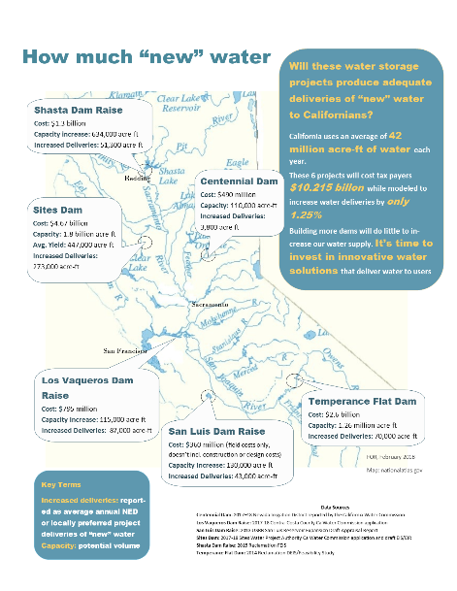
Cal Fed-like Investigation
Dams
Storage: Approximately 4 million acre-feet proposed for study
Yield: Approximately 500 thousand acre feet average annual increased deliveries. Cost $10.2 billion
Representing an increase in statewide storage of 12% and increasing average annual water supply deliveries 1.25%.

Slide 7
Status of Projects
Shasta Dam Raise (USBR):
Final Feasibility Report – July 2015
Final EIS – Dec. 2015
No Recommended alternative
Temperance Flat Dam (USBR)
Draft Feasibility Report – Jan. 2014
Draft EIS – August 2014
Incomplete draft EIR submitted to CA Water Commission
by SJVWIA

Slide 8
Status of Projects
Third Los Vaqueros Dam raise (USBR/DWR/CCWD):
Water Commission application
Lots EIS/EIR work
Probably will be a recommended alternative
Sites Reservoir (DWR then Likely Sites Project JPA to take over):
No Feasibility Report
Administrative Draft EIR – December 2013
Water Commission submission of DEIS/DEIR
Likely to have an EIR with preferred alternative
San Luis Dam raise: (USBR)
Appraisal Report – December 2013

Slide 9
Status of Other Dam Projects
Centennial Dam (Parker Dam on Bear River)
(Nevada Irrigation District)
Water Commission zero score, NID voted not to appeal
CEQA NOP – 2016
New Exchequer Dam (Merced Irrigation District)
Dam raise (Congressional testimony to de-designate National Wild & Scenic River)
Invasion of Corps of Engineers-required flood pool (Merced ID paper. No Water Commission application)

Slide 10
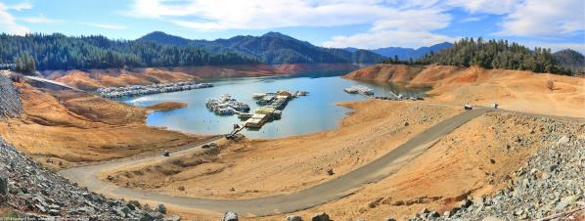
Shasta Dam Raise
Estimated Cost: $1.3 billion
Additional Capacity: 634,000 acre feet
NED Project Average Annual Water Delivery Yield: 51,300 acre feet
Water Beneficiaries: Apparently Westlands and Santa Clara Water Authority
Key issue: Illegal under California law. Not eligible for bond subsidies

Slide 11
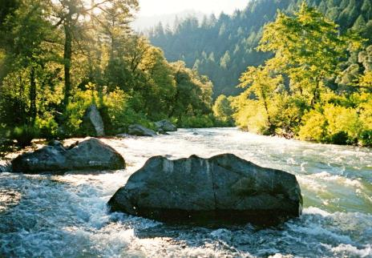
Outstanding Considerations
No legal cost-sharing partners
No water rights to serve SWP
Allocation of costs within CVP
Illegal to construct, illegal to receive bond subsidies
No support from resources agencies
Native American cultural resources

Slide 12
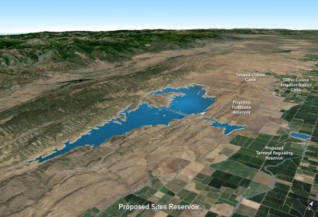
Sites Reservoir
Estimated Cost: $4.7 billion
$4.2 billion CWC, $6.3 Fed estimate according to LA Times
Capacity: 1.8 million acre feet
Average Annual Water Supply Delivery Increase 273 thousand acre feet
Sites Authority Draft EIR
Water Beneficiaries: Area farmers, SWP & CVP urban water contractors, delta outflow
Key issues: 1) Environmental protections for Sacramento River not established, 2) Cost and beneficiaries and cost-sharing partners (MWD not on board without tunnels).

Slide 13
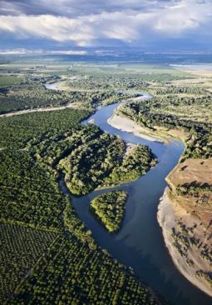
Potential Outstanding Considerations
Operating rules for diverting 5,900 cubic feet per second into reservoir don’t exist
Beneficiaries and water rights
Financing
Owner is likely to have to re-scope and begin new CEQA analysis with revised project description

Slide 14
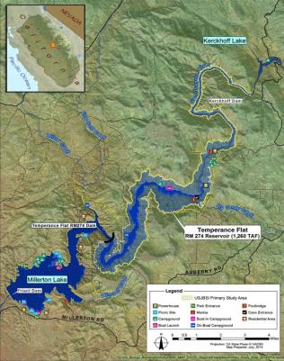
Temperance Flat Dam
Estimated Cost: $2.6 billion
Storage Capacity: Up to 1.3 million acre feet
Average Annual increased deliveries:
(70,000 NED Project, Authority has plans for more if shared with westside and SWP/MWD)
Key issue: River is fully appropriated, no water rights are available for storage legal operations by the Temperance Flat Dam

Slide 15
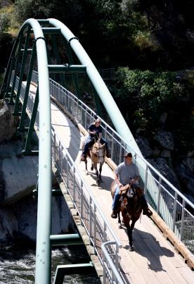
River Gorge Impacts
The Temperance Flat Dam will flood:
8 miles of the San Joaquin River Gorge – a river recommended by the BLM for National Wild & Scenic River protection.
A BLM recreation area visited by 84,000 people annually
Three campgrounds, an outdoor education center and natural history museum
Segments of San Joaquin River National Recreation Trail and two other National Trails

Slide 16
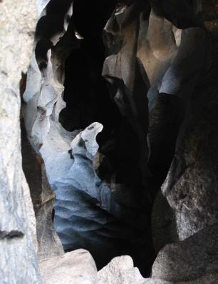
River Gorge Impacts
The Temperance Flat Dam will also flood:
The unique Millerton Caves system
A class III-V whitewater kayak run
Habitat for many special status wildlife and plant species
Many historical and cultural sites, some eligible for the National Register

Slide 17
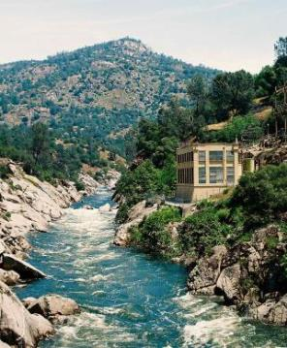
Unresolved Issues
Ownership. Beneficiaries. Financing. Likely loss of water to Friant Project customers. Allocation of costs within CVP
Water rights (river system fully appropriated and Reclamation contemplates customers outside of CVP legal place of use)
Native American cultural resources
Environmental impacts and mitigation requirements. No support from natural resources agencies
Special designations (BLM’s Wild & Scenic River recommendation)
Hydropower mitigation (PG&E’s reaction to proposed mitigation for loss of powerhouses is unknown)

Slide 18
Other Projects
San Luis Dam Raise: No obvious project owner eligible for water bond funding
Exchequer Dam: Raising dam violates the National Wild & Scenic Rivers Act and is therefore ineligible for bond funding. Invading flood reservation needs Corps of Engineers approval (at minimum). No formal applications have been made.
Centennial Dam: $300 to $500 million dollar project whose principal feature is to legally capture water currently held by another water-right and dam owner. Nevada Irrigation District is on an aggressive schedule to complete EIR and EIS for needed permits.
Tulare Lake: Use of Tulare Lake for floodflows and subsequent water use for potential CVP, SWP, local beneficiaries.
A small host of small projects, often involving groundwater.

Slide 19
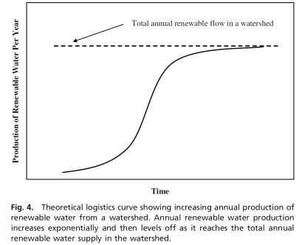
An obvious conclusion: we’ve reached “Peak Water” for many California watersheds
This concept is developed in “Peak water limits to freshwater withdrawal and use” by Gleick & Meena Palaniappan, Pacific Institute (the figures are from here)
Key watersheds are on the right end of the potential production curve making potential watershed yield gains small

Slide 20
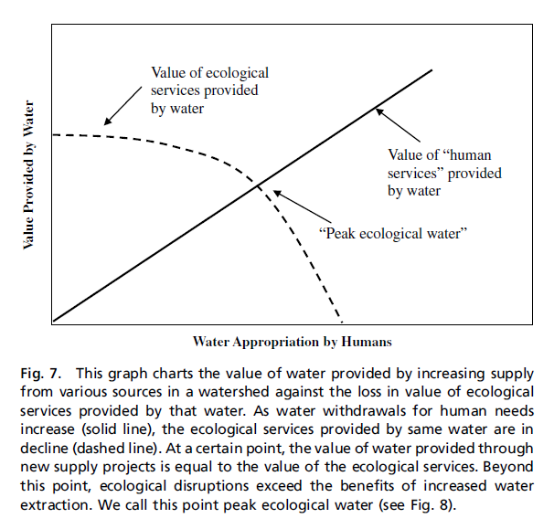
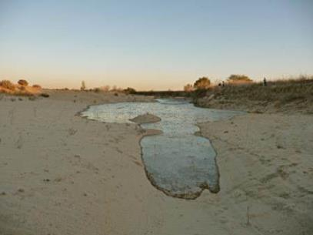
And in some watersheds restoration is in the public interest, not increased water extractions

Slide 21
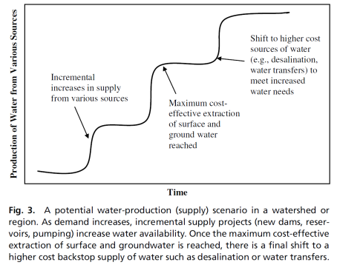
And additional supply is costly
Key watersheds and key uses have reached the end of the “cost-effectiveness of new-supply” step-function curves

Slide 22
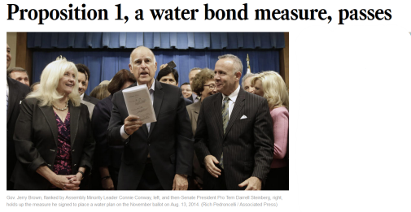
California’s recent response: offer to subsidize public benefits of storage projects
Public benefits do not include agricultural and municipal & industrial water uses.
Water Commission staff seems disinclined to let supplicants just spin stories about their public benefit ideas

Slide 23
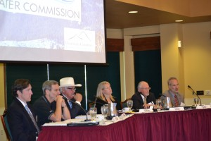
California Water Commission
Responsible for allocating Prop. 1 funds for the environmental, water quality, and other public (taxpayer subsidized) benefits from new water surface or groundwater storage
$2.7 billion is likely to be awarded on the basis of comparative value
Likely to rely on EIRs from project proponents, but others can offer advice

Slide 24
California Water Commission
Will decide the maximum conditional eligibility grants early this summer.
Money is not awarded until EIRs are done and permits secured.

Slide 25
California Water Commission
Whether the Commission is able to spend most of its money or not, the statewide supply and San Joaquin Valley groundwater overdraft realities won’t be much affected much

Slide 26
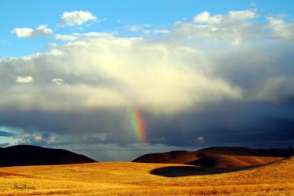
Back to Reality: some pointing positive
The state’s recently passed groundwater legislation (SGMA) is going to force realistic assessments of groundwater and surface water availability and living within supply means
The only realistic and sufficient tool for the big agricultural groundwater overdrafters will be demand reductions. Little can be done with supply augmentations.
Urban water suppliers able to command higher retail prices for water will find investments in conservation, recycling, transfers, system repoerations, and yes, a little in storage (often groudwater) to be useful in increasing supply reliability and augmentations.
Californian’s will have to be creative, but solutions for most economically reasonable needs will find their way forward. The prospects for restoring key rivers and watersheds remain clouded and need to be addressed.

Slide 27
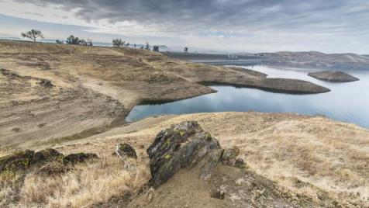
Thoughts For The Day
“…the problem isn’t that we don’t have enough reservoirs,
the problem is that there isn’t enough water in them.”
John Holdren, White House Science Advisor
“It’s hard to dam your way to Paradise in California anymore.”
Ronald Stork, Friends of the River

Slide 28
For more information, contact:
Steve Evans
Consultant – Friends of the River
Phone: (916) 708-3155
Email: sevans@friendsoftheriver.org
Ron Stork
Senior Policy Advocate – Friends of the River
Phone: (916) 442-3155 x220
Email: rstork@friendsoftheriver.org
For referenced fact sheets and other information on proposed dams, visit,
www.friendsoftheriver.org

