Slide 1

Oroville Dam Complex Sagas
Miscues, Regulator Mistakes,
and Reflections on Where We’ve Been
and the Mysteries of Where We Are Going?
California Rivers Day Legislative Briefing
State Capitol, May 3, 2017
Presented by Ron Stork, Friends of the River

Slide 2
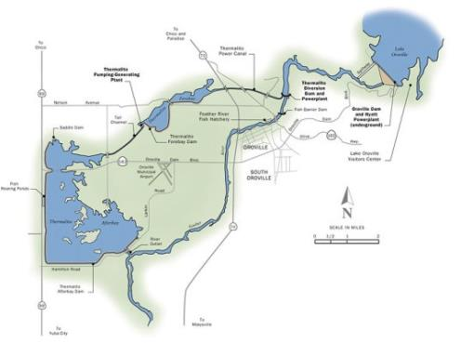
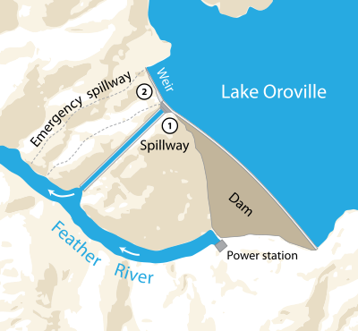
Some Geography

Slide 3
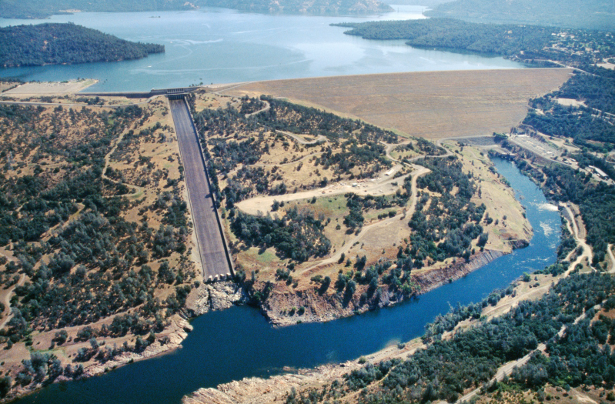
More Geography

Slide 4
Oroville Dam Factlets
3.5 million acre-feet “keystone of the State Water Project currently undergoing relicensing. 750,000 acre-feet flood space reservati0n, 150,000 acre-feet surcharge reservation
17,000 cfs powerhouse; 5,000 cfs river outlets
296,000 cfs main service spillway (at spillway design flood)
350,000 cfs auxiliary/emergency spillway (as above)
Operated according to 1970 ACE reservoir regulation manual (“interim” operations [actual conditions] are limited to one paragraph and one page). Objective release, 150,000 cfs

Slide 5
1997 Floods
Record Oroville Dam inflow (300,000 cfs) Record outflow (160,000 cfs) (hourly data)
City of Oroville told to stand by to evacuate in twelve hours if DWR has to begin pass-through (300,000 cfs) operation. Downstream communities evacuated.
However, reservoir storage peaked 200,000 acre-feet (13.8 ft), well below emergency/auxiliary spillway crest.
Feather River left-bank levee breaks downstream of Marysville (Country Club Lane Break).

Slide 6
Response
Yuba Feather WorkGroup forms (funded by CALFED) by 2000
Focus: improving floodwater management in Feather River Basin
Most active participants: Yuba County Water Agency, Sutter County, Levee District 1, South Yuba River Citizens League, Friends of the River, Sierra Club, DWR.
Deficiencies with Oroville Dam’s emergency/auxiliary spillway are frequent part of discussions.
Concern is that general havoc (hillside erosion) will prevent operators from undertaking Corps-manual surcharge operations to contain combined spillway outflows within downstream levees when required. Further, use could result in loss of crest control. That would be bad. Solution: a real spillway.

Slide 7
Lack of Response and Counter Response
Written analysis of spillway deficiencies made available to DWR date back to August 23, 2001.
Yuba County Water Agency publishes August 2002 Technical Memorandum describing, in part, havoc associated with use of emergency spillway.
Detailed discussions with DWR FERC-licensing staff take place in 2002 through 2004. DWR takes position the spillway matter is not appropriate for a relicensing proceeding. Workgroup members believe otherwise.
In January of 2004, WorkGroup informs DWR that it recognizes stalemate and informs DWR that stakeholders will bring the matter to FERC licensing proceeding. FOR files comments in June 2004 with FERC objecting to DWR’s position.
In October 2005, FOR/SYRCL/Sierra Club Intervene citing YCWA technical memorandum plus concern that use could result in loss of crest control. Sutter County, Yuba City, and Levee District 1 file for intervention later also raising these issues. FOR et al. argue operational requirements of dam are not supported by the physical structures (i.e. emergency spillway).

Slide 8
Hiding the Ball or Self-Decption?
FERC Licensing in DC asks FERC Dam Safety in San Francisco what they think of Intervention issues (May 26, 2006)
DWR assures FERC Dam Safety that emergency spillway can safely pass spillway design flow (350,000 cfs). Speaks of only 1 to 4 feet of erodible soil on hillside.
Bypassing the operational issues of problems with use of emergency/auxiliary spillway, FERC SF Dam Safety assures FERC licensing staff the emergency/auxiliary spillway can safely pass spillway design flood. (July 27, 2006)
Conclusion document from FERC SF Dam Safety is only document made available. Any work (if any) supporting the conclusions is secret (CEII).
FERC licensing accepts SF FERC Dam Safety conclusions and fails to propose any spillway improvements at Oroville Dam but does accept our description of DWR’s ACE operational requirements. (2006)
SWRCB issues water quality certification (2010)

Slide 9
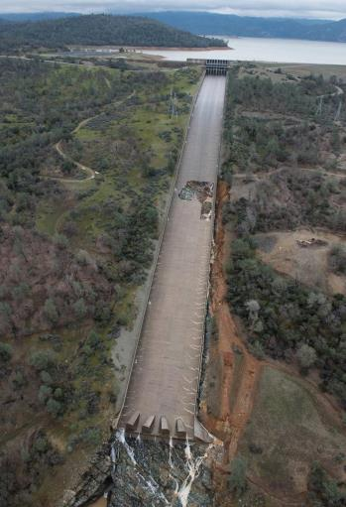
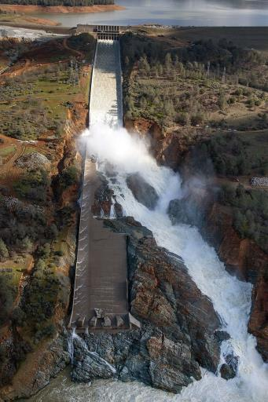
2017 Spillway Incident

Slide 10
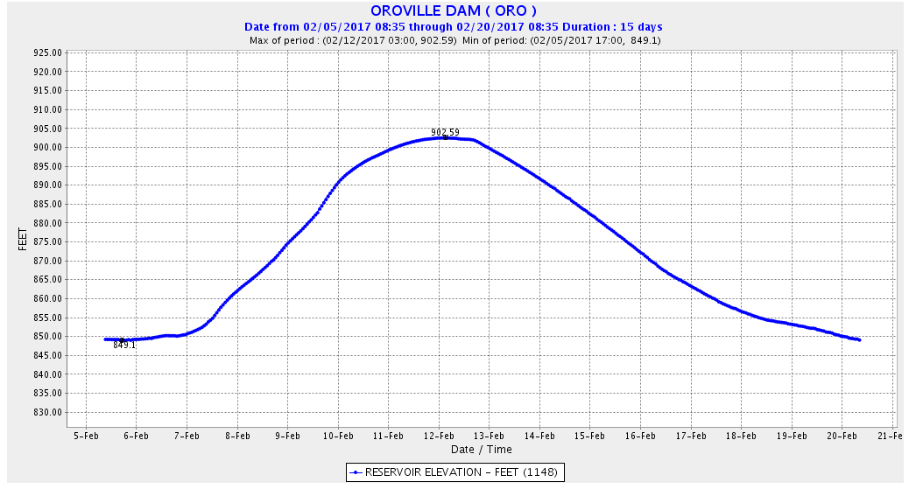
Oroville Incident Reservoir Levels

Slide 11
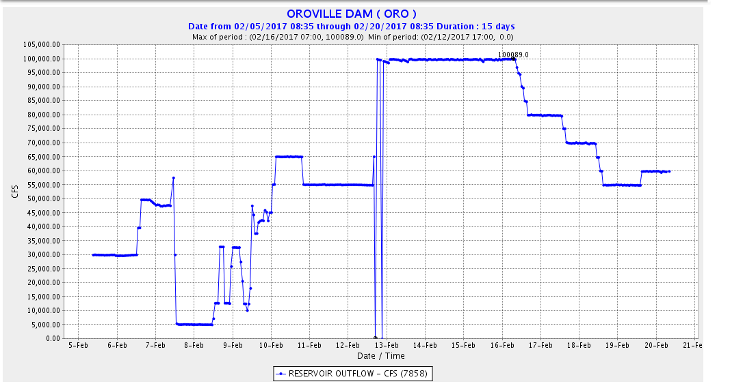
Oroville Incident Outflows

Slide 12
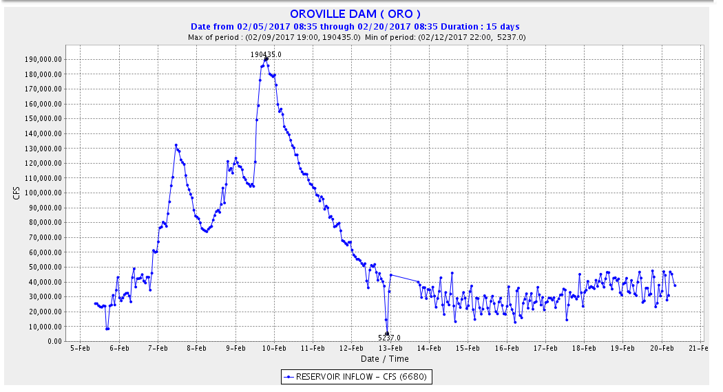

Slide 13
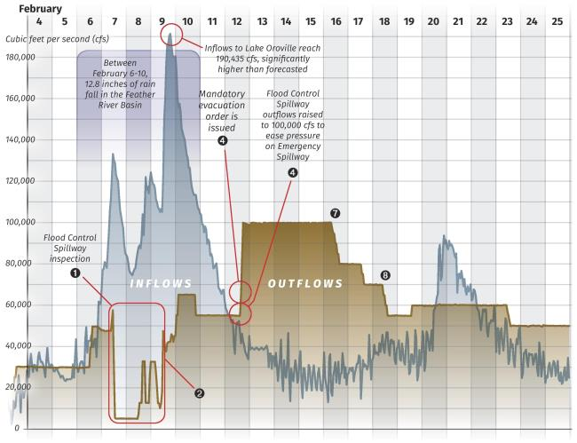
Oroville Incident Flow Synthesis

Slide 14
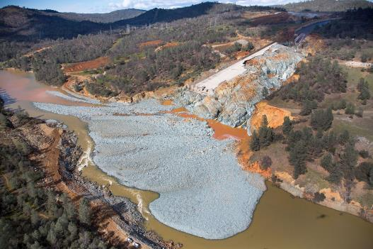
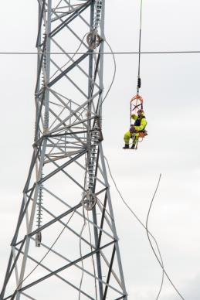
Havoc

Slide 15
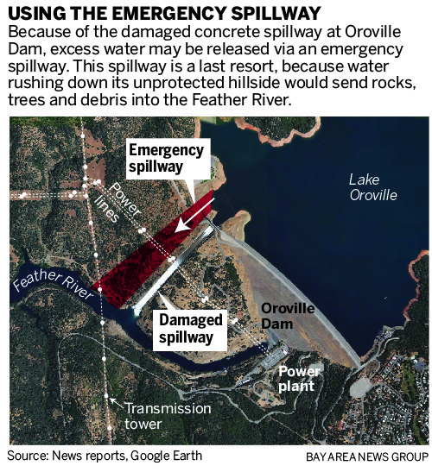
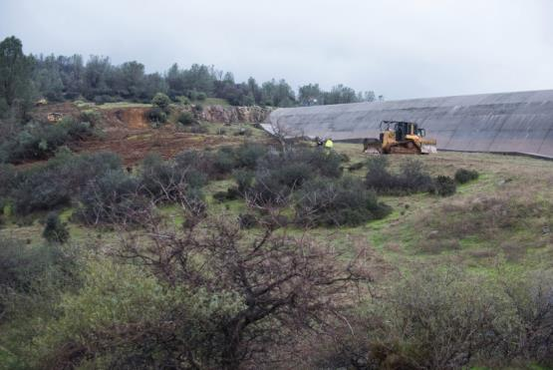
More Havoc

Slide 16
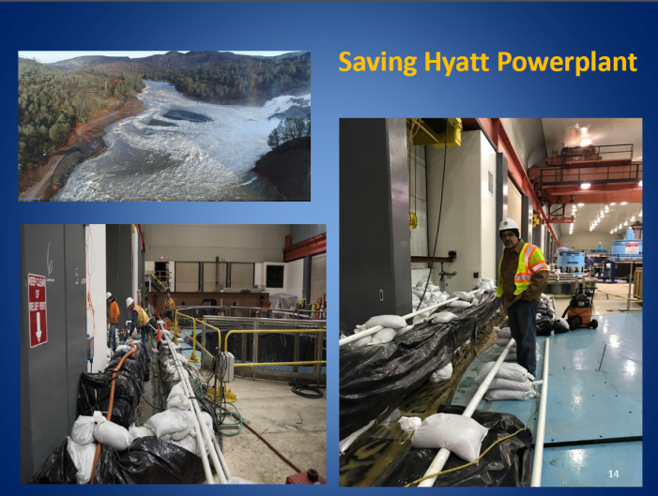
More Havoc

Slide 17
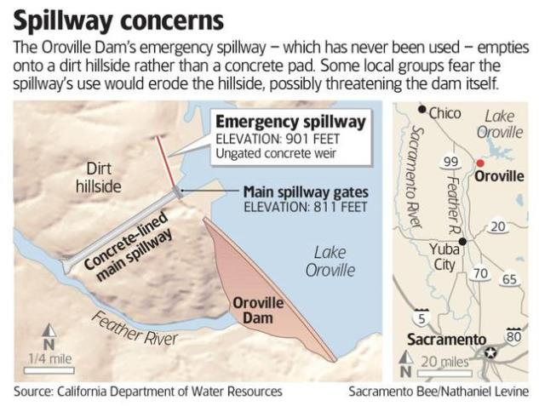
Using the Auxiliary Spillway would be a bad thing, perhaps very bad
Actual fear was loss of hilltop crest control and catastrophic release of top of reservoir. The threat to the dam structure itself would require considerable hillside failure, probably only a remote possibility

Slide 18
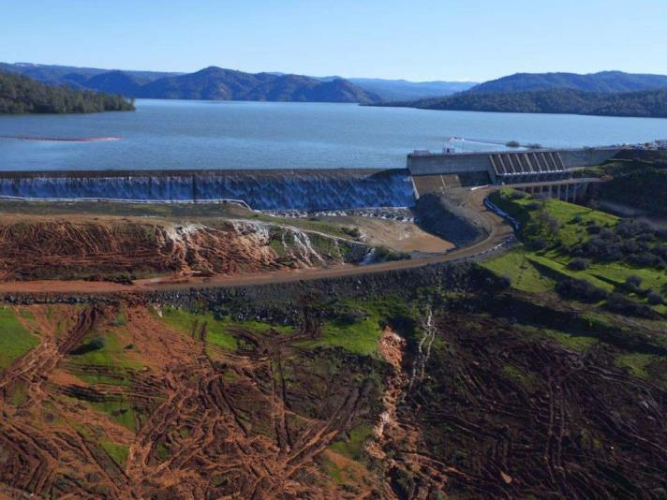
From Bad to Worse
The Temperance Flat Dam will flood:
8 miles of the San Joaquin River Gorge – a river recommended by the BLM for National Wild & Scenic River protection.
A BLM recreation area visited by 84,000 people annually
Three campgrounds, an outdoor education center and natural history museum
Segments of San Joaquin River National Recreation Trail and two other National Trails

Slide 19
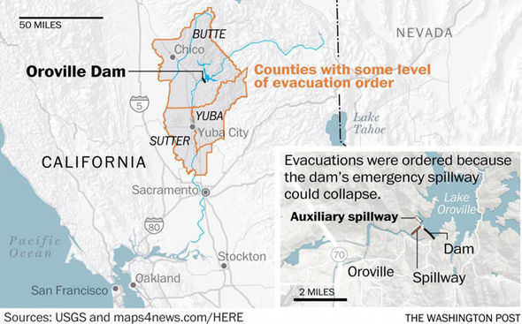
And Near Catastrophe

Slide 20
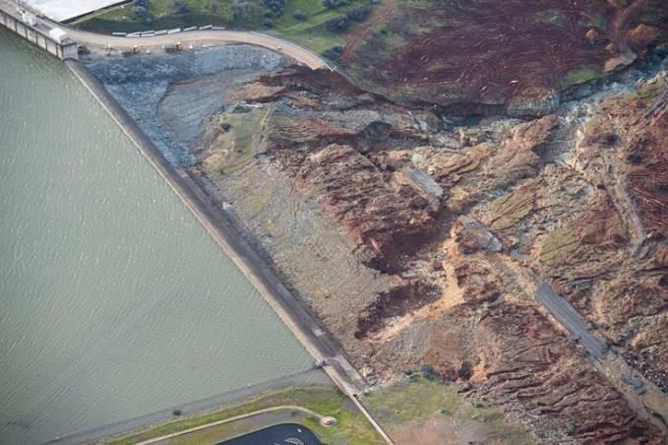
Imminent Failure, Day After

Slide 21
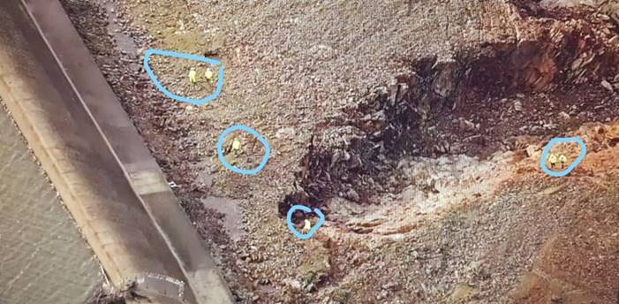
Imminent Failure, Day After

Slide 22
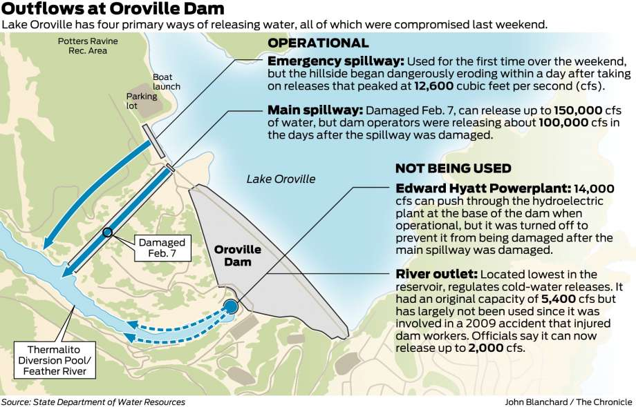
All outlets compromised

Slide 23
Short-term Recovery Actions
Dredging out Oroville Dam afterbay to relieve pressure on powerplant and enable restart
Rerouting powerlines to avoid danger zones and keep powerplant on line. Reroute major PG&E transmission line
Stabilize auxiliary/emergency spillway hilltop
Shorterm stabilization of dangerous erosion features to main spillway

Slide 24
Next One or Two Construction Seasons
Stabilize and reconstruct the main spillway
Construct spillway on emergency/auxiliary hilltop (without hillside spillway still an incomplete spillway causing havoc if used)
Potentially permanently rerouting powerlines to avoid danger zones and keep powerplant on line. Redundant powerlines

Slide 25
Following Construction Seasons
Construct full spillway to prevent severe hillside erosion if used. (Without explicitly stating so, as of this writing DWR apparently has rejected this necessary fix.)
Ensure that radial gates have sufficiently redundant power. (Not sure this will be assessed for need or undertaken since Bulletin 200 description may not represent current conditions.)
Find a way to increase reliability and capacity of low level outlets and powerhouse releases and increase their capacity (Relying on powerhouses to reliably make reservoir regulation releases can be tricky business.)
Consider construction of a lower-level outlet/spillway capable of making releases in advance of extreme storm inflow.s (Although Oroville’s low-level flood-release capabilities aren’t bad, they may need to be improved if a complete emergency spillway option is selected and the surcharge flood reservation has to be transferred to the conservation pool.)
Identify and fix other identified problems that may threaten the infrastructure and the operability of the Oroville Dam complex (for example, there may be some through-dam seepage that may need attention)

Slide 26
Forensic Investigation
FERC Dam Safety has asked DWR to conduct a study to determine the cause of the spillway failures
Much of DWR and FERC’s in-progress thinking is behind a veil of CEII secrecy. DWR has proposed to make the report public (although parts will be redacted)
It is unclear if the review will determine the causes of DWR and State and Federal Dam Safety official’s failure to discover or appreciate havoc-causing or dam-safety issues during design, life of project, or licensing review. This may involve sociologic factors

Slide 27
Major Unresolved Problems
Likely resistance of State Water Contractors to paying the bill for reconstruction and appropriate levels of maintenance
DWR and Dam Safety Regulator’s view that emergency/auxiliary spillway use or operational need is extremely unlikely (even to 1/10,000 or 1/100,000 annual risk levels, although Oroville has either been told to evacuate or evacuated twice in life of project because of feared use)
Much of DWR and FERC’s in-progress thinking on forensics and design is behind a veil of CEII secrecy. DWR has proposed to make the forensics report public (although parts will be redacted)

Slide 28
Major Consequences
Veil of secrecy prevents public from informed consultation with DWR and FERC on reconstruction and making the Oroville Dam complex safe decisions
DWR, state and federal dam safety officials, and FERC licensing appear to have no concept that havoc-causing or unsafe emergency/auxiliary spillway design defeats the likelihood of ACE-required managed floodwater-management surcharge releases from the dam. The result: decreased flood protection for downstream communities

Slide 29
Solutions
This incident highlighted a major failure of dam-safety regulators (state and federal). This should be a major focus of at least one influential forensics report. The report(s) should recommend reforms and they should be adopted
Contracts with state water contractors should cover costs of ongoing maintenance and addressing design deficiencies that affect project operations, safety, reliability or other necessary programs.
DWR and Federal regulators need to quickly construct a more reasonably transparent Oroville Dam complex reconstruction and rehabilitation process that allows an informed public to affect design decisions now being undertaken in considerable secrecy (this might not have been necessary if DWR and the State Water Contractors had not fought off reconstruction and rehab during relicensing)

Slide 30
Final Reflections
Dams, although much praised for their functions, are also dangerous. The legislature and water agencies should be more cautious about authorizing or funding them just assuming that dam-safety and environmental decisions will be made responsibly. The failures at Oroville should have been caught during design, through dam safety reviews, during contract reviews, during relicensing, and even the 2017 process. The weren’t in the past, and some appear not to be heading for a satisfactory conclusion either in 2017 or in the coming years.
The Oroville Dam Spillway incident drew worldwide press. California and FERC need to understand that they need to resolve all of the deficiencies, both physical and institutional, if we are to be viewed as the world leader we aspire to be. On the transparency front, it is not an auspicious start.

Slide 31
Photo Credits
San Jose Mercury News
Associated Press
Department of Water Resources
Wikipedia
Sacramento Bee
Dave Gutierrez, GEI Consultants, recently retired chief of the DWR Division of Safety of Dams
Los Angeles Times
San Francisco Chronicle
Washington Post
(It should be noted that some of these photographers headed into the evacuation zone, risking their lives to “get the story.”)

Slide 32
For more information, contact:
Ron Stork
Policy Director – Friends of the River
Phone: (916) 442-3155 x220
Email: rstork@friendsoftheriver.org
For some of this information, visit the Oroville Dam page at
www.friendsoftheriver.org
http://www.friendsoftheriver.org/our-work/rivers-under-threat/feather-threat/

